Slide 1

Helium SW Debug Training

Slide 3
Embedded Software Debug Features and Flows
Flows and High Level Features
Native Interactive embedded software debug on virtual cores: Symbolic debugging for debug-built (-g) images and disassembly debugging for all images. Debug bare metal programs, 32-bit and 64-bit Linux including kernel modules and Android. Will extend to Linux applications in the future. Supported for ARM virtual cores (SystemC). Support for other cores coming in future releases.
Native Interactive embedded software debug on RTL cores: With support for debug on ARM v9-a, v8-a, v7-m RTL cores (Xcelium simulation, Palladium, Protium). More ARM architectures and cores coming in future releases.
Multi-core and multi-process software debugging in same design.
RTL Register and Memory Access at Software Breakpoints
Synchronized Debug on Virtual and RTL cores
Integrated Software Debug and Signal Level scripting for automation of Hardware and Software tests
Full-featured Software Debug GUI based on Eclipse CDT including Helium-customized views for:
Processor/Core Selection and Stack Frame Management in Debug View.
Examining core registers for both virtual and RTL cores in dedicated Register View.
Viewing source code disassembly with ability to show side-by-side with source, instruction step or source step, set breakpoints in Disassembly View.
Source code editing with powerful C/C++-aware Source Code View. Outline View for syntax-based navigation.
Viewing local variables and parameters in Variables View and other variables and expressions in Expressions View.
Debugger access to the memory of virtual and RTL models. View and change memory values in configurable Memory View.
Browsing source files of images in Helium Image Browser View.
Examining parameters, registers, and ports of virtual components in Helium System View.
Breakpoint management, including process and core specific breakpoints, conditional breakpoints, hardware breakpoints, watchpoints, Breakpoint View.
Issuing debug commands in Interactive Console View synchronized with GUI.
Managing debug sessions, run-time options and configuring software images using debugger configuration files in Images/Symbols View.
Embedded software debug scripting language integrated with RTL/SystemC scripting: Includes scripting language with full suite of symbolic debug operations, processor control and kernel module debug.
Support for debugging Linux kernel modules: Helium built-in knowledge of Linux internal data structures enable kernel debug

Slide 4
Example Overview
After product setup, you can run examples illustrating software debugging
Some of the platforms in `xmroot`/tools/esl/modelcatalog/releasecatalog are setup to show how to use the Helium Debugger
vexpress/a35_m7_gic400_hybrid
vexpress_v9/klein_gic600_ufs
vexpress_v9/matterhorn_gic700_virtio
Examples include README and RUNME files - See README files for complete instructions to use.

Slide 5
Agenda
Save to Catalog
Add / Remove Virtual Models
Parameter Config / Port Binding
Rewire Interrupt and Memory Map
Add / Remove RTL Stubs
Hybrid Adaptors & RTL Connection
RTL Sidechanges
Overview - Helium SW Debugger
Launch - Helium SW Debugger
Tools Setup & Helium Invocation Commands
Getting started with: Arm-v9 Hybrid Platform
Preparing - Helium SW Debug Configurations
Debug Configuration - Create ,Manage and Run
ESW Configuration File Overview (Images/Symbols)
Connecting - Helium SW Debugger
Two Connection Approaches based on debug use cases
Working With an RTL Platform
Debugging - SW Debug Perspective
Overview of Helium SW Debug GUI
Debugging Features
SW/HW Debug Scenarios
How to Debug a Hang
Debugging Linux
Debugging Platforms
Command Language and Scripting
Notes:
Review items #3,4 to some more meaningful title.
[ankit]: Think if sub-section can be deleted: Tools Setup & Helium Invocation Commands

Slide 6
Overview - Helium SW Debugger

Slide 7
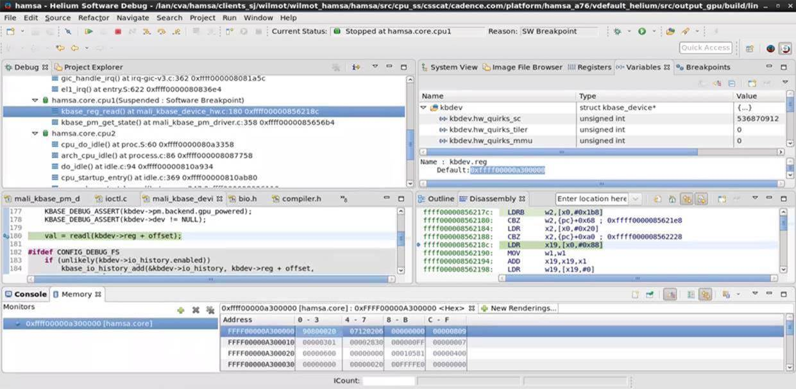
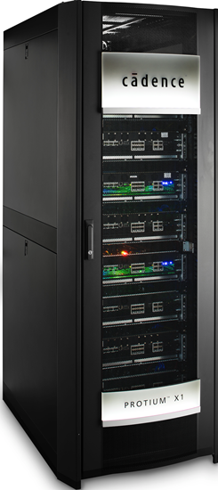
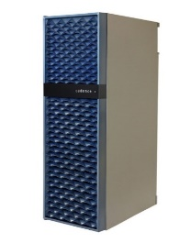


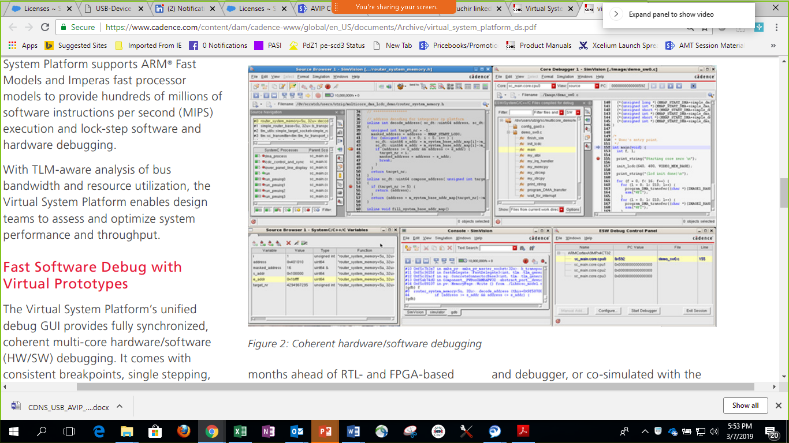

Helium Unified Software Debug Across Runtime Engines
SoC
CPU
CPU
UART
System
Boot
INTC
CSI
USB2
Timer
DSI
USB3
Ethernet
SATA
Display
…
MC
GPU
IP 2
Mem
DDR3
Software Tests
OS
SoC Drivers
CPU Sub-system
SoC
UART
System
Boot
INTC
CSI
USB2
Timer
DSI
USB3
Ethernet
SATA
Display
…
Helium
Xcelium
Protium
Palladium
MC
GPU
IP 2
MMP
DDR3
Multi-core, multi-processor Debug
Hardware-Software Command Console
Mixed Abstraction Software Debug
CPU Sub-system
SoC
Memory View
Variable View
Breakpoints
Core specific Stack View
CPU
CPU
UART
System
Boot
INTC
CSI
USB2
Timer
DSI
USB3
Ethernet
SATA
Display
…
Customized System View
Powerful TCL scripting with HW & SW visibility
MC
GPU
IP 2
Mem
DDR3
Linux Kernel Module Debug
Dynamic Disassembly
Live RTL IP Register Values
Register View

Slide 8
Key Embedded Software Debug Features
Full-featured Interactive Software Debug Capabilities (derived from Eclipse CDT)
Multi-Core and Multi-Processor Debugging in same session
Native Interactive embedded SW debug on virtual and/or RTL processor cores
System View to examine virtual components and registers (and parameters)
Current Debug State (current stop reason, location, number of instructions, etc.)
Full-featured scripting language integrated with hardware debugging commands
Debugger access of memory in virtual or RTL models
Native integration with runtime engines (Helium, Xcelium, Palladium, Protium)
Full-featured Software debug scripting integrated with hardware debug scripting in tcl
Live debug view of addresses whether mapped to virtual or RTL components
Synchronization between software and hardware run and stop
Support for debugging Linux kernel modules

Slide 9
Launch - Helium SW Debugger

Slide 10
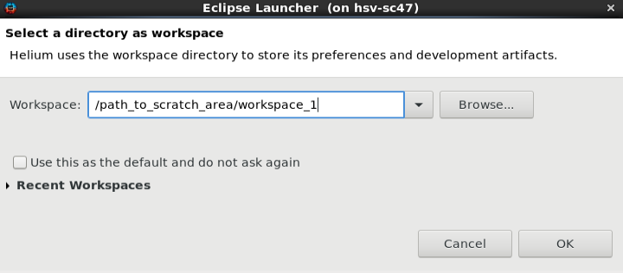
Tools Setup & Invocation - Helium SW Debug GUI
Tools Setup & License :
> source /lan/cva_rel/helium21h1/21.05.s001/helium_setup.csh
Invoke Command:
> helium &
A dialog to select a workspace will appear
Select a new workspace when using helium for the first time
On subsequent runs, workspaces created with helium can be selected with the drop-down arrow
Notes:
Merge these multiple slides and clean-up – Done
[Ankit] – 09/08 – Following text removed for Basic Training. Review if this is required to keep.
Interactive Command Line Debug
> xrun –helium –esw <esw_option> -tcl …
Scripted Debugging
> xrun –helium –esw <esw_option> -input <scripting file> …

Slide 11
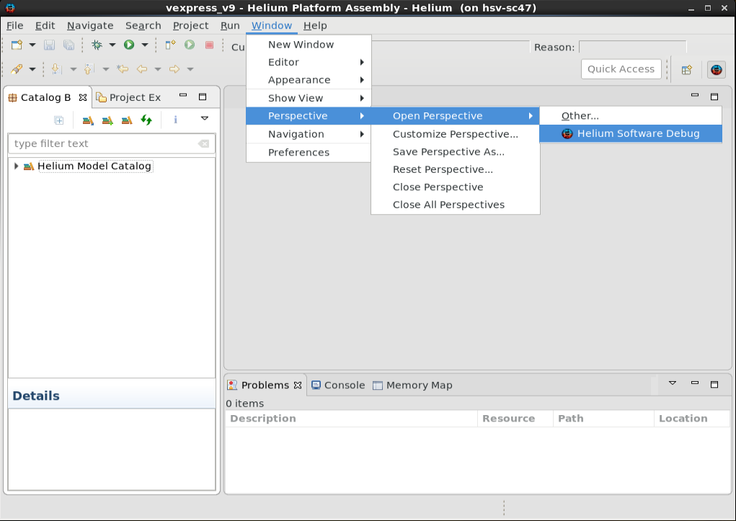
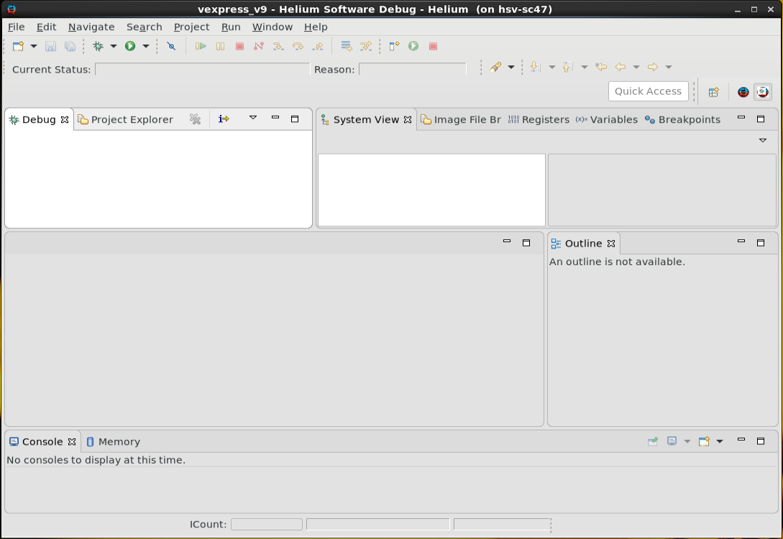
Select - Helium SW Debug Perspective
1. Default view -> Platform Assembly
2. Switch to -> Helium Software Debug Perspective
Helium Software Debug Perspective (Default View)
This icon can be used to switch back to Helium Platform Assembly
Notes:
[Ankit] – Added. Confirm if its ok. Also added pic in next slide. Decided what is better to show and update slide accordingly. Remove highlighted if we keep next slide.

Slide 12
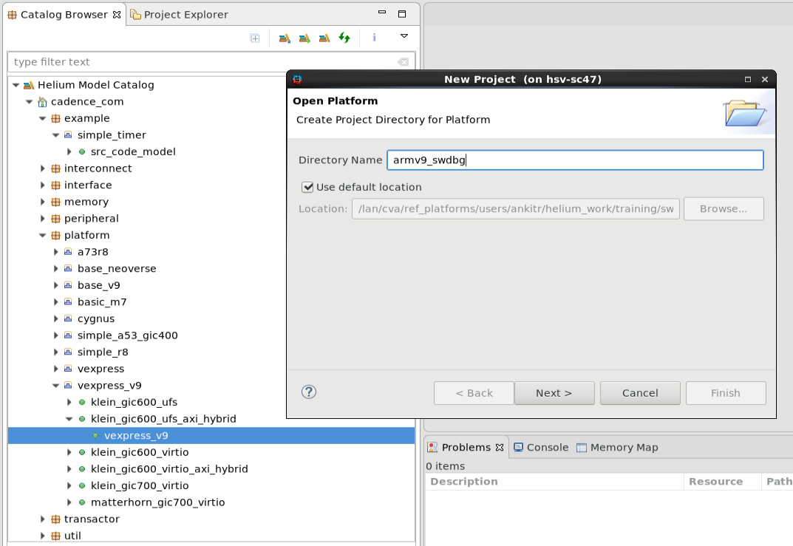

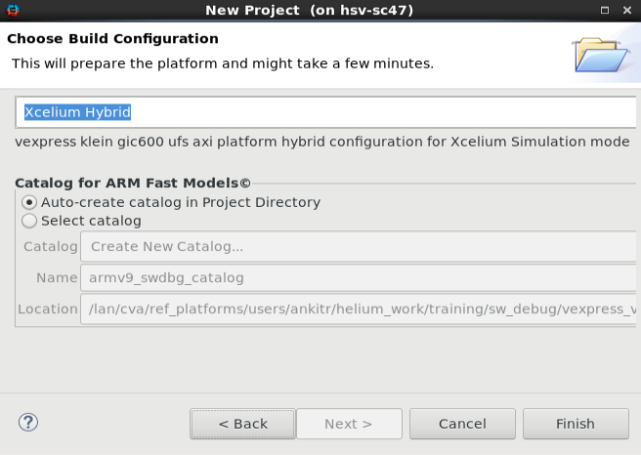
Getting started with Example: Arm-v9 Hybrid Platform
1
1. Switch to Helium Platform Assembly View
2. Choose Any Example from Helium Model Catalog Platforms
3. Double click to Open Platform
2
4. Select the shown options to run on Xcelium
5. Click on Finish
Built-in Examples
4
3
5

Slide 13

Getting started with Example: Arm-v9 Hybrid Platform
Build ARM-FM
After clicking on “Finish”
Platform Opened In Design Editor
After successful Fast model build, Platform will be opened in Design Editor
Build Platform
Click on Project -> Build Platform
Run Platform
Start Building Fast Models present in Platform
Click on Run -> Run Platform
Default Test -> Hello World
Platform is Ready to setup “Debug Configurations”

Slide 14
Preparing - Helium SW Debug Configurations

Slide 15
Debug Configuration
Debug Configurations are used to set platform run options and select software images to run
Helium Software Debug contains commands and options required to run platforms
The Images/Symbols tab provides an editor to create or update the Debugger Configuration File
A single platform can contain multiple Debug Configurations to run with different hardware and software options

Slide 16
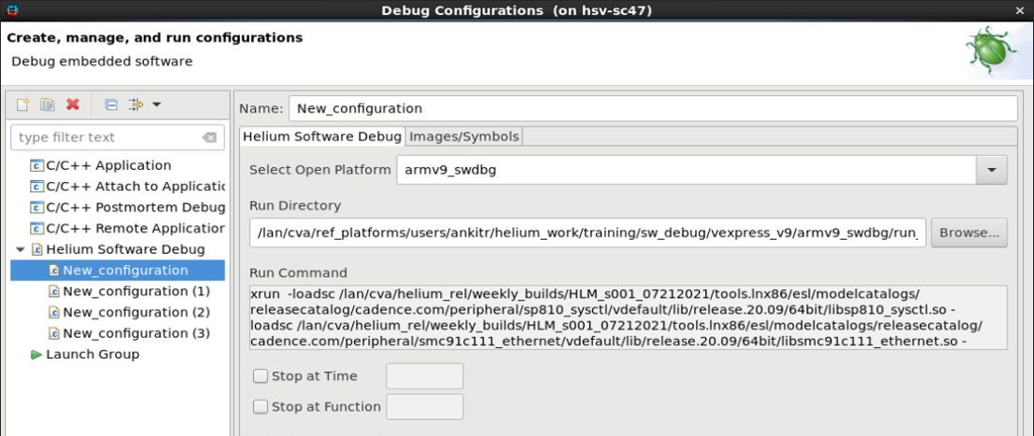
Preparing - Helium SW Debug Configurations
What is Debug Configuration?
In the Helium Embedded Software Debug tool, you can create a “debug session” by providing run options and provide a reference software image and symbols to start SW debugging
You can name the debug session based on need.
Create, Manage and Run – Such Multiple Debug Configurations
Helium Software Debug
ESW Configuration File (Images/Symbols)
Notes:
[Ankit] – new slide added. Show this section live in Demo, when ever necessary.

Slide 17
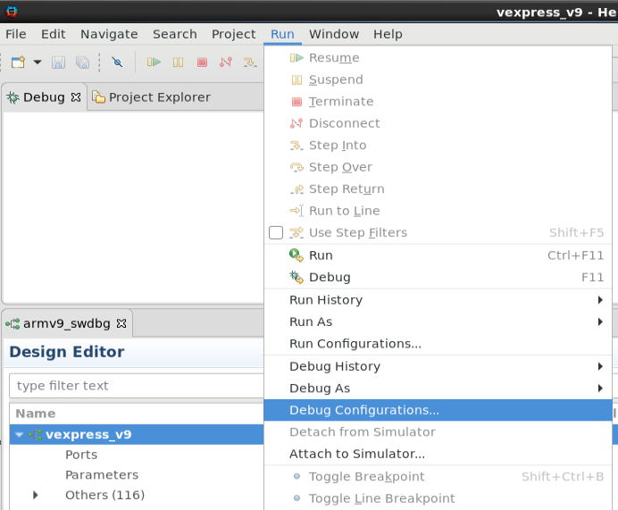
Preparing - Helium SW Debug Configurations
Helium Software Debug
Click on Run -> Debug Configuration
Double-click on the “Helium Software Debug” text in the left pane
Provide Name of configuration
Provide Run Directory Path
Entering a command in the “Run Command” text box to invoke xrun
Selecting the Platform, will pre populate ‘Run Directory’, ‘Run Command’, ‘Extra Run Arguments’ which were utilized for Platform Bring up
You can press the Apply button to save settings
Click on Debug button to launch the Debug Configuration which named as “New_configuration”

Slide 18
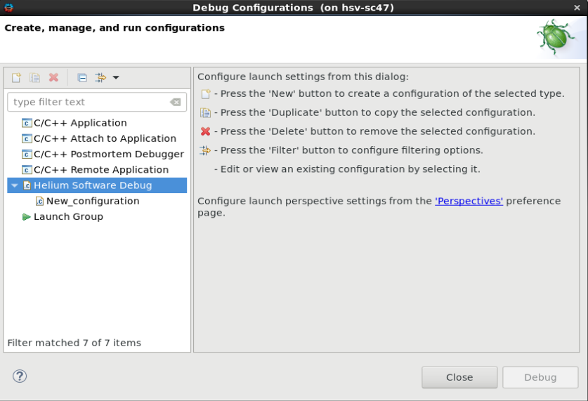
Preparing - Helium SW Debug Configurations
Helium Software Debug
Click on Run -> Debug Configuration
Double-click on the “Helium Software Debug” text in the left pane
Provide Name of configuration
Provide Run Directory Path
Enter a command in the “Run Command” text box to invoke xrun from script
Selecting the Platform, will pre populate ‘Run Directory’, ‘Run Command’, ‘Extra Run Arguments’ which were utilized for Platform Bring up
You can press the Apply button to save settings
Click on Debug button to launch the Debug Configuration which named as “New_configuration”

Slide 19
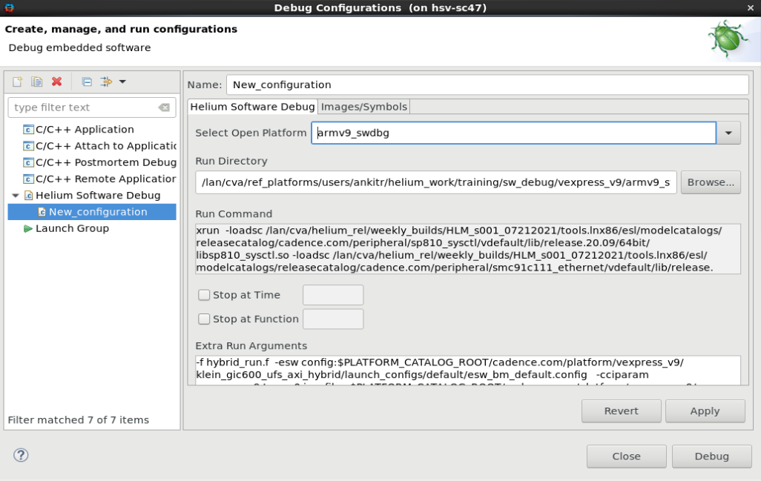
Preparing - Helium SW Debug Configurations
Helium Software Debug
Click on Run -> Debug Configuration
Double-click on the “Helium Software Debug” text in the left pane
Provide Name of configuration
Provide Run Directory Path
Enter a command in the “Run Command” text box to invoke xrun from script
Selecting the Platform, will pre populate ‘Run Directory’, ‘Run Command’, ‘Extra Run Arguments’ which were utilized for Platform Bring up
You can press the Apply button to save settings
Click on Debug button to launch the Debug Configuration which named as “New_configuration”

Slide 20
Preparing - Helium SW Debug Configurations
Helium Software Debug
Click on Run -> Debug Configuration
Double-click on the “Helium Software Debug” text in the left pane
Provide Name of configuration
Provide Run Directory Path
Enter a command in the “Run Command” text box to invoke xrun from script
Selecting the Platform, will pre populate ‘Run Directory’, ‘Run Command’, ‘Extra Run Arguments’ which were utilized for Platform Bring up
You can press the Apply button to save settings
Click on Debug button to launch the Debug Configuration which named as “New_configuration”

Slide 21
Preparing - Helium SW Debug Configurations
Helium Software Debug
Click on Run -> Debug Configuration
Double-click on the “Helium Software Debug” text in the left pane
Provide Name of configuration
Provide Run Directory Path
Enter a command in the “Run Command” text box to invoke xrun from script
Selecting the Platform, will pre populate ‘Run Directory’, ‘Run Command’, ‘Extra Run Arguments’ which were utilized for Platform Bring up
You can press the Apply button to save settings
Click on Debug button to launch the Debug Configuration which named as “New_configuration”

Slide 22
Preparing - Helium SW Debug Configurations
Helium Software Debug
Click on Run -> Debug Configuration
Double-click on the “Helium Software Debug” text in the left pane
Provide Name of configuration
Provide Run Directory Path
Enter a command in the “Run Command” text box to invoke xrun from script
Selecting the Platform, will pre populate ‘Run Directory’, ‘Run Command’, ‘Extra Run Arguments’ which were utilized for Platform Bring up
You can press the Apply button to save settings
Click on Debug button to launch the Debug Configuration which named as “New_configuration”

Slide 23
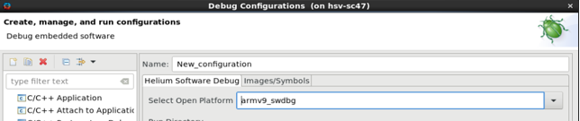
Preparing - Helium SW Debug Configurations
ESW Configuration File (Images/Symbols)
Why do we need a ESW Configuration File?
A ESW Configuration File is a single place to specify software related associations. It specifies:
Names of processors and sub-cores
Location of associated source code/images/symbols to load and their loading mechanisms
Connection information to the virtual CPU
Connection information to the RTL CPU (RTL BFM path, protocol, etc.)
Specify the Configuration File to xrun using this option:
-esw config:<path_to_configuration_file>

Slide 24
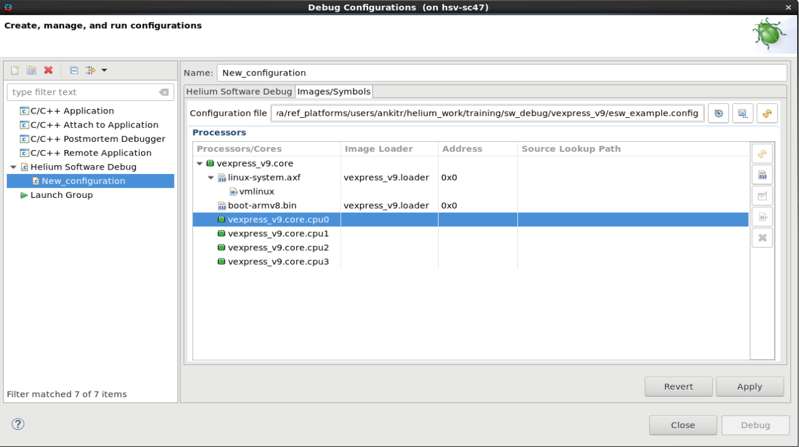
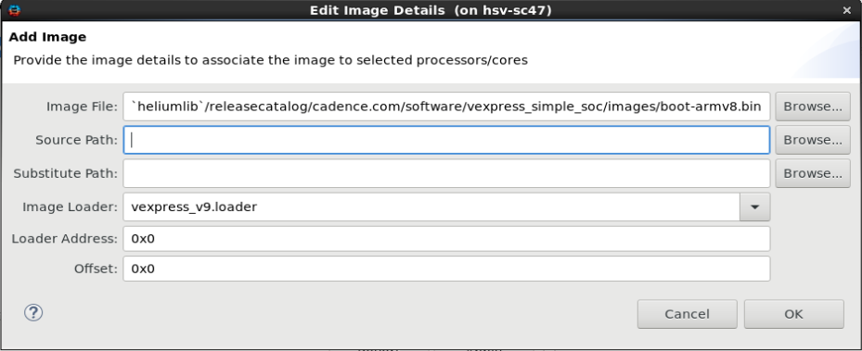
Preparing - Helium SW Debug Configurations
ESW Configuration File (Images/Symbols)
Save a copy of Configuration
Select the Config file using the browse button.
Refresh the processor, core data from the source platform when the platform is open in an editor.
Add Images
Edit Images
Add Symbol File
Remove

Slide 25
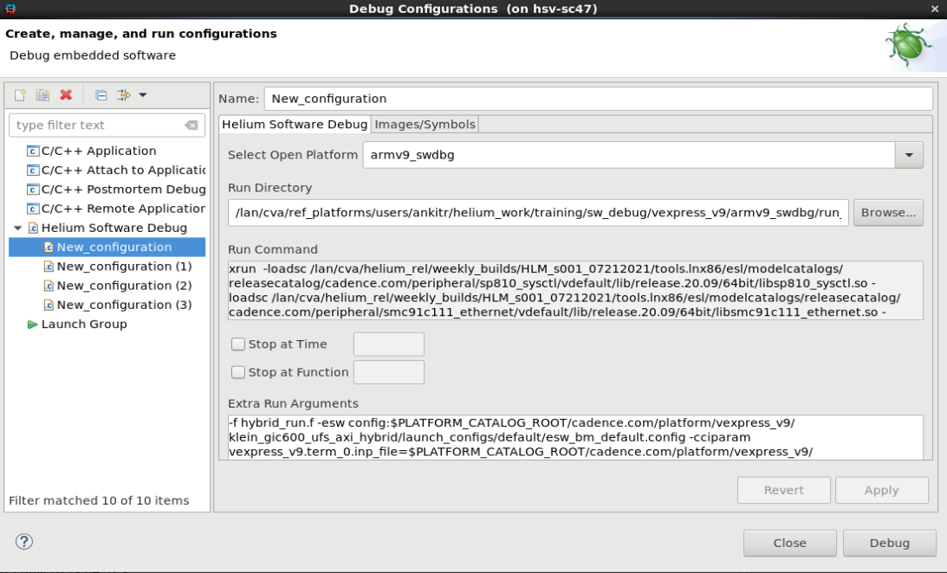
Preparing - Helium SW Debug Configurations
Helium Software Debug
ESW Configuration File (Images/Symbols)
Multiple Debug Configurations can be maintained and then selected/edited in the GUI
Create, Manage and Run – Such Multiple Debug Configurations
A single platform can contain multiple Debug Configurations to run with different hardware and software options

Slide 26
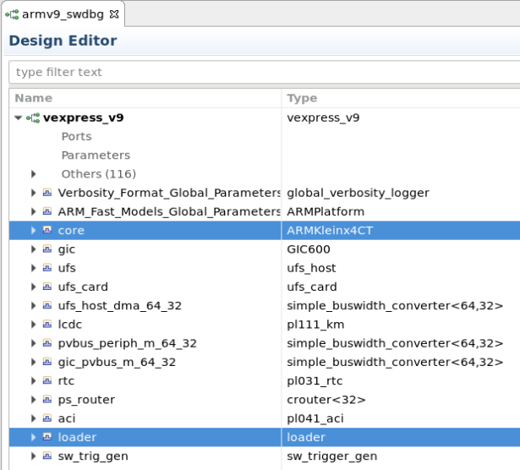
Arm-v9 Hybrid Platform Example- Configuration File Processors section: virtual CPU
processor {
name vexpress_v9.core
abstraction virtual
image {
load /path/to/linux-system.axf
symbolfile /path/to/vmlinux
loader vexpress_v9.loader
source /path/to/linux/src/dir
}
cores {
core {
name vexpress_v9.core.cpu0
coretype armv9a
}
core {
name vexpress_v9.core.cpu1
coretype armv9a
}
core {
name vexpress_v9.core.cpu2
coretype armv9a
}
core {
name vexpress_v9.core.cpu3
coretype armv9a
}
}
}
Helium GUI
Configuration file fragment

Slide 27
Processors section: RTL CPU
Abstraction is RTL
processor {
abstraction rtl
bfm
{
path tb_top.a76_apb_bfm
type apb
adapter dpi
}
image {
load /path/to/linux-system.axf
symbolfile /path/to/vmlinux
source /path/to/linux/src/dir
}
cores {
core {
name platform_name.RTLProcessor0.cpu0
coretype a76
}
core {
name platform_name.RTLProcessor0.cpu1
coretype a76
}
core {
name platform_name.RTLProcessor0.cpu2
coretype a76
}
core {
name platform_name.RTLProcessor0.cpu3
coretype a76
}
}
Debugger BFM RTL path and protocol
Configuration file fragment
Notes:
[Ankit] 16-sep – Add real example from n2

Slide 28
Processor/Gearshift Configuration File Syntax
config {
<processors_section>
[<gearshift_section>]
}
<processors_section> ::=
processors {
[<processor_info>]…
}
<gearshift_section> ::=
gearshift {
[<gearshift_group>]…
}
Standard hybrid configuration
New for Gear Shift

Slide 29
Processors Section
Name for display in GUI and use in TCL commands
<processor_info> ::=
processor {
name <processor_name>
abstraction <abstraction_type>
[<bfm_info>]
[<image_info>]
<cores_section>
}
Either virtual or RTL
Specifies the BFM that can be used for debugger queries
Path to images to load, loading mechanism, path to symbol info, source code, etc.
Provides information about names and number of cores within processor

Slide 30
Additional RTL processor related information
RTL path of a BFM that can be used for debugger queries
<bfm_info> ::=
bfm {
path <path_to_bfm_instance>
type <bfm_type>
[adapter <adapter_type>]
}
The protocol to use when communicating with the BFM
One of apb, ahb, axi or jtag
Note: apb has high performance
Adapter used to communicate with the BFM
One of dpi or vdi
Note: dpi is optimized for debug
Notes:
[Ankit ]Dpi or vdi – Confirm this with R & D
[Ankit] - apb, ahb, axi or jtag – Call out for performance and what is best for Helium

Slide 31
Cores Section
Lists the names and types of the individual cores which are part of the processor
<cores_section> ::=
cores {
[<core_info>]…
}
<core_info> ::=
core {
name <full_path_name>
coretype <core_type> |
<core_name>
}
<core_type> := armv8a | armv7m
<core_name> := a76 | a53
<full_path_name> must include processor portion of the path. E.g. processor1.cpu0
To use gearshift, specify a <core_name> instead of <core_type>. Helium needs to know the exact core and not just the architecture.

Slide 32
The –esw option to xrun
Syntax: -esw config:<config_file>
The config file will identify virtual/RTL processor paths, connection type (e.g. VDI/APB) for RTL cores, other needed information to configure connection to RTL
If config file is specified multiple times only first occurrence is processed
Notes:
-esw option values also serves today to prepare databases for Indago ESWD – that use model is not supported with Helium
Usage of –esw as above enables all Helium command/debug engine support and requires Helium licenses

Slide 33
Connecting - Helium SW Debugger
Notes:
[Ankit] 09/08 – title changed from “Connection to Simulation for Software Debug” to

Slide 34
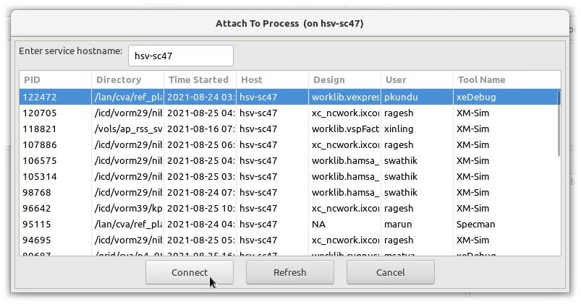
Based on Use cases
Helium SW Debug Config Launch
Launching the session is closely tied and under the Control of the Helium SW Debugger
Walk Up Connection
Connect to already Running Simulation on PZ1/PZ2 or Protium
Detach simulation from Helium SW Debugger on the Go without killing the run and continue simulation
Remote Host connection
Customize the commands quickly in GUI before launch
Create/Save customized Run, Debug settings associated with a given platform
Change software images, associated symbols using the Images/Symbols tab and launch multiple SW runs without closing the GUI.
This approach allows interactively setting breakpoints at points of interest before starting the debug session
Attach simulator to Helium SW Debugger by selecting PID from the prompted window
Debugging Symbols (e.g. vmlinux) and source code location information can be added after attachment using the esw Tcl command
On Demand connect with Helium SW debugger after reaching the simulation run to an interested point
Notes:
[Ankit]: Confirm Protium

Slide 35
Based on Use cases
Helium SW Debug Config Launch
Click on Run -> Debug Configuration
Once Debug Configuration is prepared, click on “Debug” button to connect to Helium SW Debugger
Notes:
[Ankit]: Confirm Protium

Slide 36
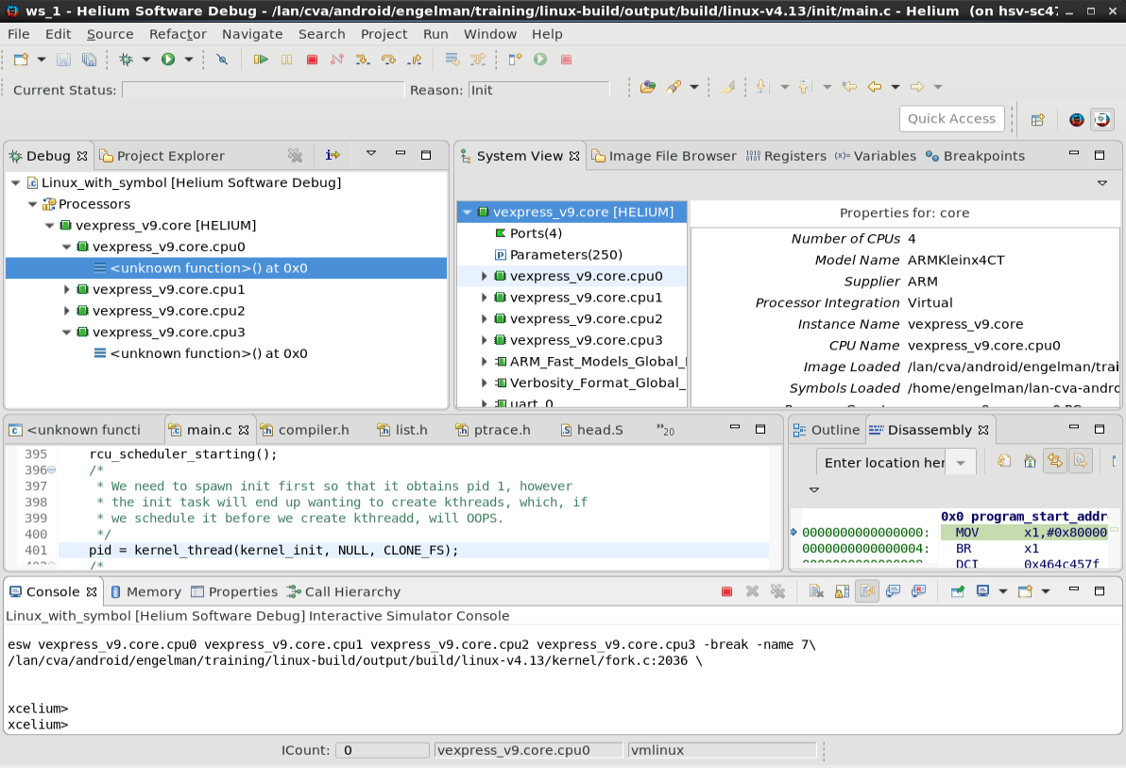
Based on Use cases
Helium SW Debug Config Launch
Once the connection is established successfully -> Helium SW Debugger Perspective
We are ready to start SW Debug !
Notes:
[Ankit]: Confirm Protium

Slide 37
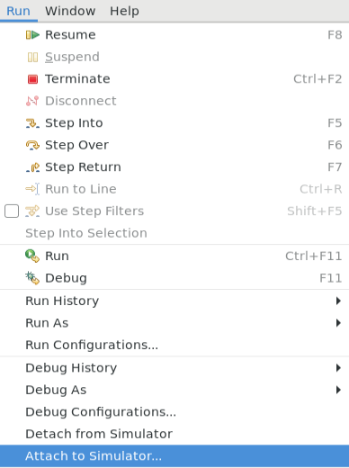
Based on Use cases
Walk Up Connection
Run the simulation using “command line” from terminal
Stop the run to the point of interest to start SW Debug
Open Helium GUI with ‘helium &’ command from any terminal
Meaning both Helium and Simulation are invoked independently
No need to add catalog OR open platform in Helium
Change the perspective by clicking on Window-> Perspective -> Open Perspective -> Helium Software Debug
Click on “Run -> Attach to Simulation”
You will be prompted with following “Attach To Process” dialog box.
Select the PID of your run and click on “Connect”
You can Detach from Simulator once done with debug
Notes:
[Ankit]: Confirm Protium

Slide 38
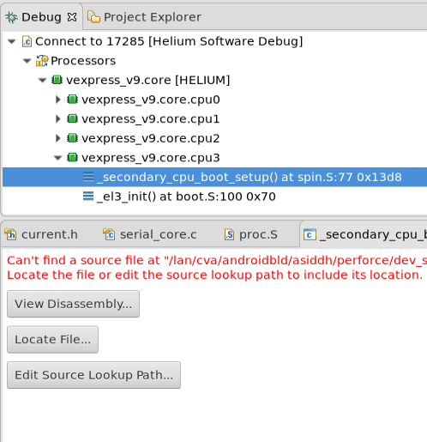
Based on Use cases
Walk Up Connection
Depending on when the simulation is stopped, we can see the C files and disassembly view accordingly
Enter esw commands in helium Console to provide path to Image and source dir, if not already set
esw –image /path/image.axf
esw –source /path_of_source_code
esw –describe -> will show the basic info of the design
esw –help -> to see command help. Refer to User Guide for more details
Use Buttons to point to Images, if prompted
Notes:
[Ankit]: Confirm Protium

Slide 39
Debugging – Helium SW Debug Perspective
Notes:
Consider making this content an interactive part of the labs

Slide 40
Default Layout Overview
Session Controls
System View
Image and File Browser
Registers View
Variables Viewer
Breakpoint Manager
Core Selection and Context
Disassembly Viewer
Source Files
Viewer/Editor
Command Console
Current Core Selection
Memory Viewer

Slide 41
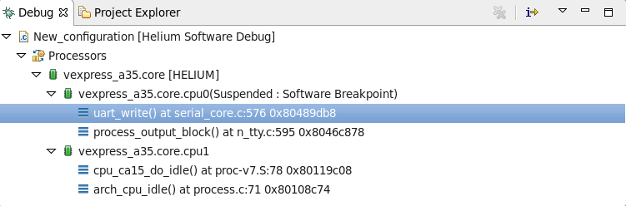
Processor/Core Selection and Stack Frame Management
Debug View provides tree of processor and cores available in system
Select different processor/core or stack frame to change active debug context.
Change of active debug context impacts other views like Variables, Disassembly, Editor and updates the current status of Debug context

Slide 42
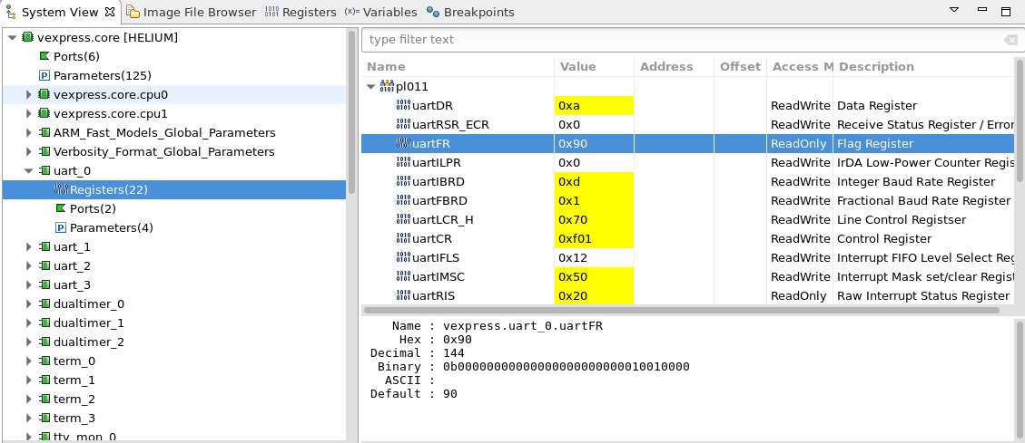
System View Basics
Register groups provides access to registers. Registers are presented by bank name.
Expand register bank and select interesting register to get value in different formats
To change value of register select register, in selected row click in Value column, edit, press Return to confirm new value or Esc to cancel
If register value has changed since last stop it will be visible with yellow background. If simulation is running values are not updated and it is not possible to change value
System View: Provides access to different components associated with a CPU:
- Properties, peripheral registers and CCI parameters

Slide 43
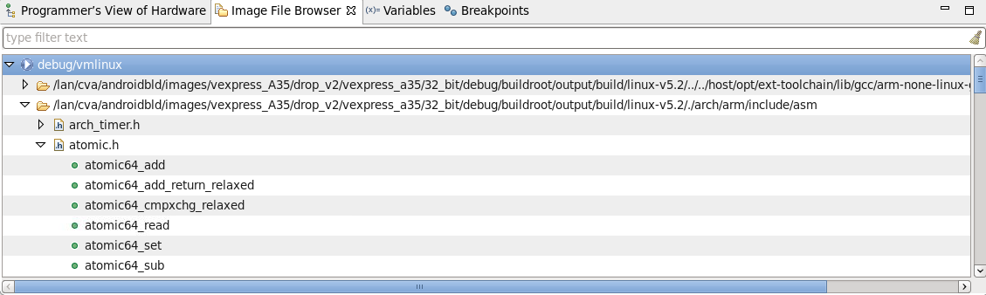
Image File Browser View - Overview
Image File Browser helps navigate between source files
Image File Browser presents list of source files with functions related to image for selected CPU
If Image File Browser is empty make sure that image is associated with selected CPU
Important: CPU is selected using Debug View

Slide 44
Commands for software debug in existing Xcelium/Xedebug command language
In addition to interactive debugging using the Eclipse GUI, a full featured command language is available for use in the console, or without the GUI.
Basic Command syntaxes
esw [<processor_list> | -all | -any | <osname>] <command_option> [<command_arguments>]…
Software debugging applied to given processors
run [<processor_list> | -all | -any | <osname>] <command_option> [-istep,-sstep,-snext,sfinish]
Software stepping applied to given processors
stop –esw <processor_list> <command_options>
Mix SW/HW conditions and actions
Use esw –help to see available command options and syntaxes

Slide 45
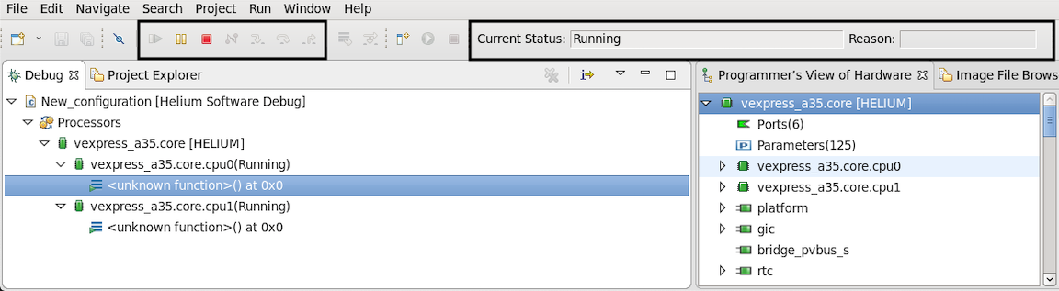
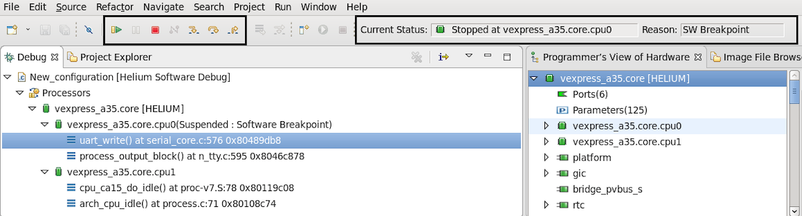
Simulation Control
Resume
Suspend
Terminate
You can control simulation using selected options from toolbar.
Toolbar contains information about current simulation status and reason of stop in case of breakpoint or watchpoint hit
Available options depends on current status of simulation
To use stepping based on source code(default), make sure that image is associated with selected CPU

Slide 46
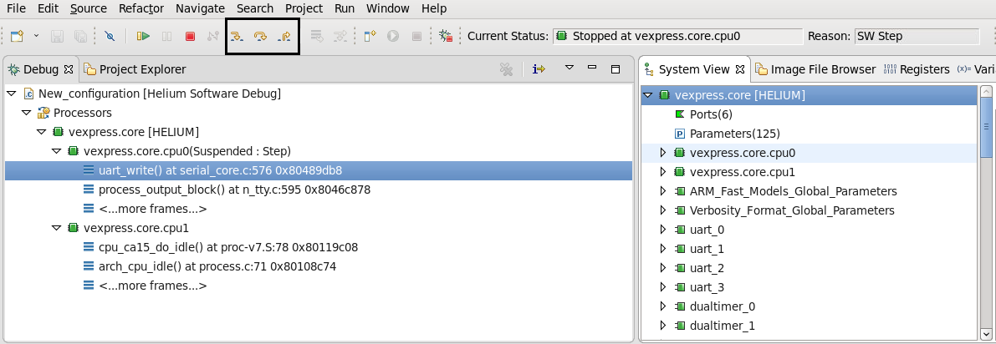
Simulation Control
Step Into
Step Over
Step Return
Instruction Stepping Mode
Click on Step Into to run simulation until it reaches next line of code to execute
Click on Step Over to run simulation until it reaches next line of code in current functions.
Click on Step Out to continue simulation until end of current function
By default, Step actions based on lines of source code. Instruction Stepping Mode is enabled in Debug View, single instructions are executed instead of lines from source code
Important: To use stepping based on source code, make sure that image is associated with selected CPU

Slide 47
Simulation Control - Commands
run -sstep run single line of code
run -snext run single line of code if current line is subroutine call, treat it as single instruction
run -sfinish run until end of current function
run -istep run single instruction
exit terminate simulation

Slide 48
Breakpoint Management
There are various methods to manage breakpoint actions:
Eclipse Views/Tabs
Image File Browser
Breakpoints Tab
Outline
Disassembly
Source
Memory
Tcl commands: esw, stop, …
Breakpoint actions include:
Setting breakpoint
Disable/Enable breakpoint
Delete breakpoint

Slide 49
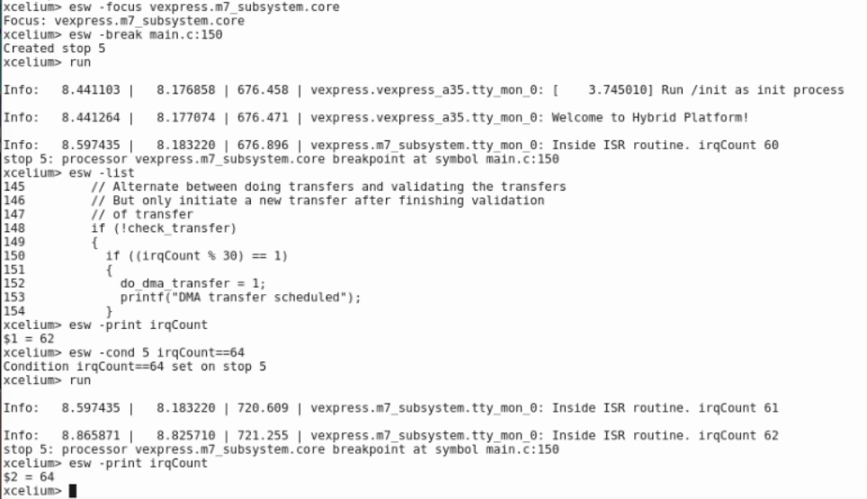
Breakpoint Management – Commands related to Breakpoints
To set a software breakpoint using the command language:
esw -break [<symbol_name> | <file_name>:<line_num> | <address>] [ -hw | -sw | -auto]
A breakpoint number will be displayed
This breakpoint number can be used in subsequent commands:
esw –disable | -enable | -delete <number>
To see all breakpoints
esw –info break
To make a breakpoint conditional:
esw –cond <number> <condition_expression>
Ignore a breakpoint
esw –ignore <number> <count>

Slide 50
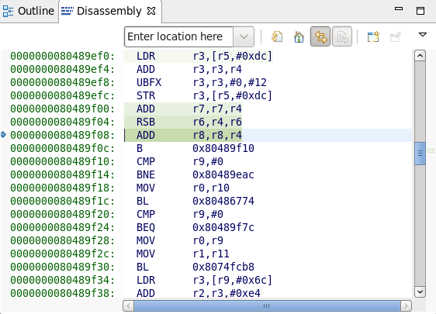
Disassembly View
If view is not visible select Window -> Show View -> Disassembly
Setting instruction stepping mode will also show view automatically
Line with arrow on left side and instruction on green background represents current PC value
Previous instructions are on lighter green background
Useful for debugging the optimized Code
Use scrollbar to navigate

Slide 51
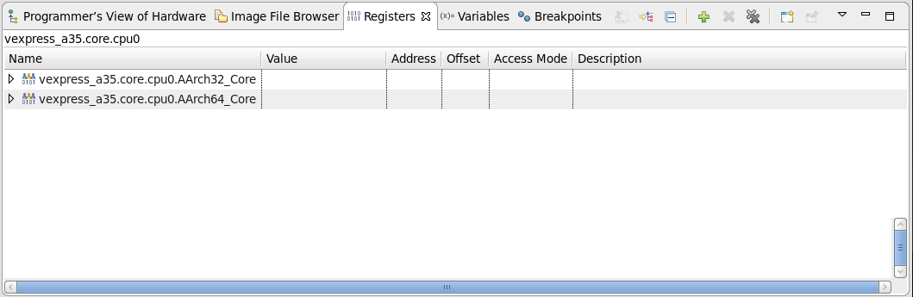
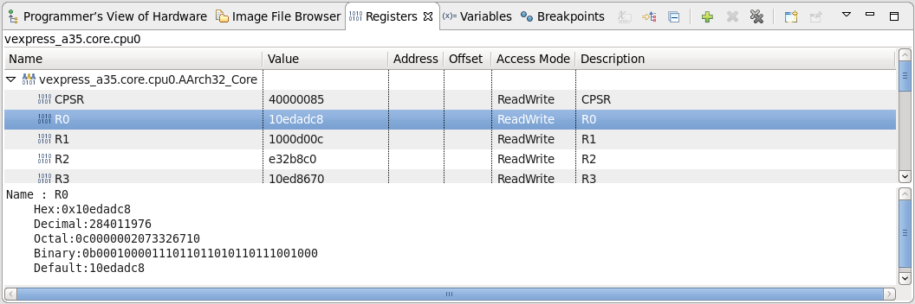
Registers View
CPU name is visible on top of view on left side
It is possible to check actual value of a register or different properties like access mode or description (if available)
Expand register bank and select interesting register to get value in different formats
To change value of register select register, in selected row click in Value column, edit, press Return to confirm new value or Esc to cancel

Slide 52
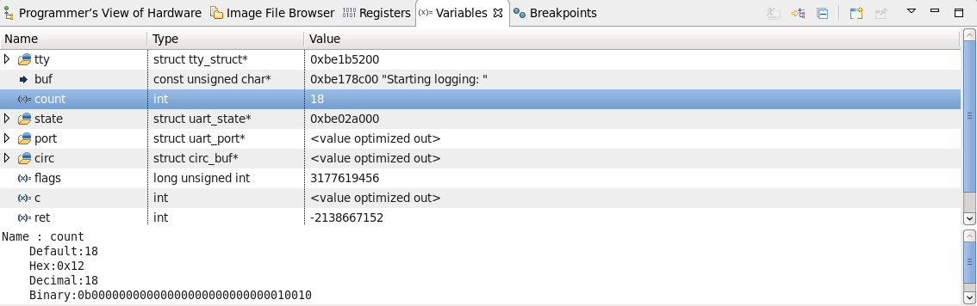
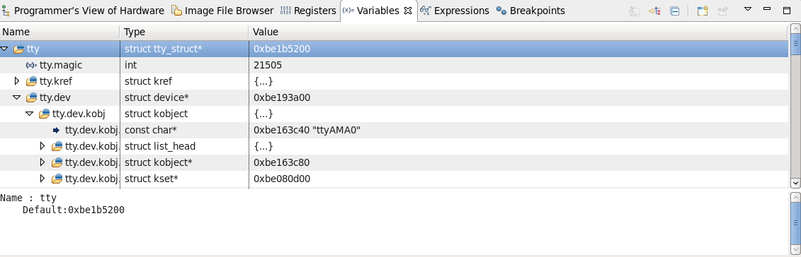
Variables View
Accessibility of variables depends on compilation settings and some variables may not be accessible
Variables available at current call stack location are displayed
You can change selection in Debug View
Select interesting variable to get value in different formats
To inspect fields of complex types like structure, expand the variable
To change value of variable, select corresponding row, in selected row click in Value column, edit, press Return to confirm new value or Esc to cancel ; it may not always be possible to change value due to compiler settings

Slide 53
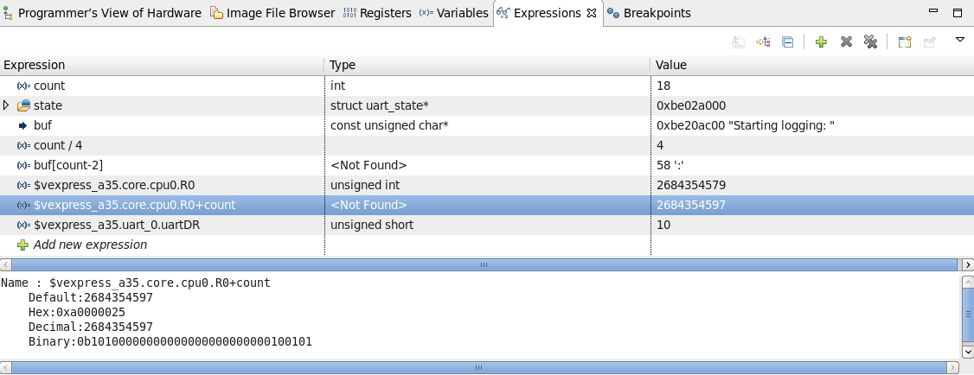
Expressions View
If view is not visible select Window -> Show View -> Expressions
View is not present in default initial layout, but adding it during a session will add for future sessions
Expression can be single variable, register or combination of both using most C operators (however, function calls are not supported)
Register should be referenced using full path
To add expression click on Add New expression row

Slide 54
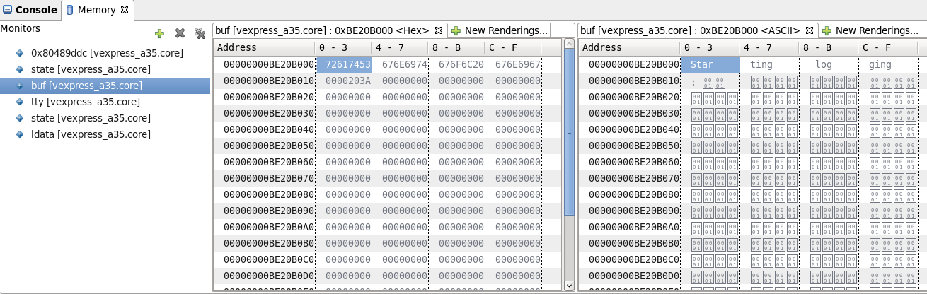
Memory View Basics
Memory view provides access to selected memory region by creating Memory Monitors
As seen from processor selected at time of Memory Monitor Creation
If processor has MMU turned on, the memory is using virtual addresses
It is possible to check selected memory address or use different source like Variables View
Memory view provides option to create watchpoint
In a hybrid platform, memory range may map to RTL devices
Viewing such memory may cause side-effects as RTL needs to run for evaluation
Notes:
Check highlighted with R & D

Slide 55
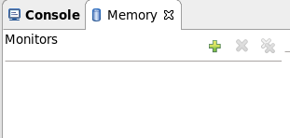
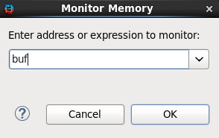
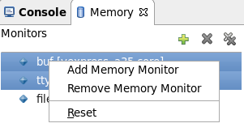
Memory View Basics
To add new memory monitor based on address, click on Add Memory Monitor in Monitors section, provide address or variable name for active debug context, confirm with OK button
To remove memory monitor(s) select monitor(s) from list and click on Remove Memory Monitor
Click on Remove All to remove all monitors
Similar actions are available in context menu

Slide 56
Software Command Language Overview
Feature | Eclipse | Relevant Tcl Commands
Image selection/file browsing | Image File Browser View | esw –image, -files, functions
Breakpoint Management | Breakpoint View | esw –break, -info break, -cond, -delete, -disable, -enable, -ignore; stop -esw
Watchpoint Management | Breakpoint View | esw –watch,-watchread, -watchwrite, -info, -cond, -delete, -disable, -enable, -ignore; stop -esw
Processor/core Selection | Debug View | esw -focus
Stack Frame Management | Debug View | esw –where,–up/-down/-frame
Control/Stepping Support | Pause/Resume, Stepping Control Buttons | run; ^C interrupt; run –sstep,-snext,-sfinish,-istep

Slide 57
Software Command Lanuage Overview
Feature | Eclipse | Tcl commands
Source Viewing | Editor Views | esw –list, -source, -substitutepath
Disassembly Viewing | Disassembly View | esw -disassemble
Local Variable Display/Mgmt | Variables View | esw –variables, -parameters, -print, -value, -set, -describe
Expression Viewing/Mgmt | Expressions View | esw –variables, -parameters, print, -value
Register Viewing/Mgmt | Registers View | esw –info component|register, -print, deposit, value
Memory viewing | Memory View | esw –memread,-memwrite, -examine
System IP register viewing | System View | esw –print,-value, -info; value; deposit

Slide 58
Software Debugging Features – Command Language Only Features
Feature | Command
Processor Control | esw –halt, -resume, -reset
Scripting Language | xrun –input, -tcl
Gearshift | esw -gearshift
Linux Kernel Module Debug | esw –osname, -debug

Slide 59
Happy Debugging !!!
Helium

Slide 61
SW/HW Debug Scenarios
ARM-FM PPU access Hang scenario

Slide 62
PPU Accesses Hang​
2. SW reads Mailbox Register and hangs as read value != 1
2
RTL
CPU Wrapper
PMU_UP
1
SoC Rest of RTL
1. Power Management Unit running firmware to initialize SoC
3
CPU-FM
3. PMU writes to PPU registers
M0 BFM
Interconnect
4. PMU reads PPU status registers and hangs as status != 1
4
PPU registers
Utility BFM
5. Mailbox is not updated and hence SW hangs
5
Helium
PMU-SS
Xcelium
Palladium

Slide 63
Hybrid Block Diagram – CPU Wrapper Connections
Virtual
ARMKleinx1CT
GIC600
VirtioP9Device
loader
pl111_km (lcdc)
simple_memory
VirtioBlockDevice
crouter
ARMTheodulDynamIQ_rtlcpu_adapter
smc91c111_ethernet
gic600_bridge
ufs_host
axi_tlm2rtl
uart
ttymonitor
ter
axi_rtl2tlm
term
slirp_wrapper
chi_tlm2rtl
ufs_card
RTL
ARMTheodulDynamIQ Wrapper
gic600_bridge
SOC RTL
AXI Slave Utility BFM
Signal Adapter
CHI Master BFM
AXI Periph Master BFM

Slide 64
Klein CPU RTL Wrapper in SoC Hybrid
(RTL CPU Wrapper in SoC)
Virtual Platform
CHI-e Master AVIP
cdn_chi_e_rnf_bfm
rtl_path
chi_tlm2rtl Adapter
Crouter
(Virtual Interconnect)
pvbus_m0
ARMKleinx1CT
Fast Model
M0 Port
pvbus_periph_m
AXI-5 Master AVIP
vr_axi_5_master_bfm
rtl_path
axi_tlm2rtl Adapter
MP Port
AXI-5 Slave AVIP
vr_axi_5_slave_bfm
rtl_path
axi_rtl2tlm Adapter
utility_bus_s
Utility port
ARMTheodulDynamIQ Signal Adapter
rtl_path
ARMTheodulDynamIQ Signal Adapter
CPU Signals

Slide 65
SW/HW Debug using Helium RTL CPU Wrapper Debug Scenario
Basic Debug Approach
Connect the Helium SW Debugger and run to the point of failure
Enable Debug Logs for HW
Enable AVIP verbosity with knobs
Enable crouter Logs
Look for the Transaction Messages printed from AVIP BFM
Get the waveform around CPU wrapper reaching to/from interconnect or around specific HW Components in SoC Design

Slide 66
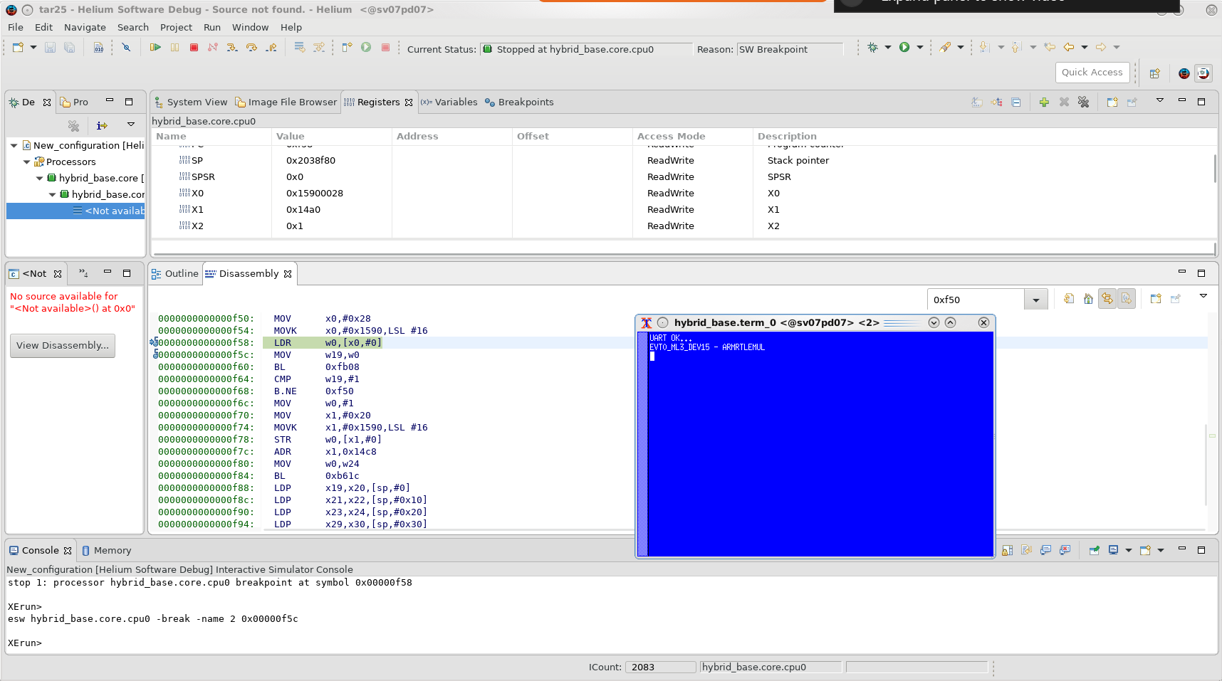
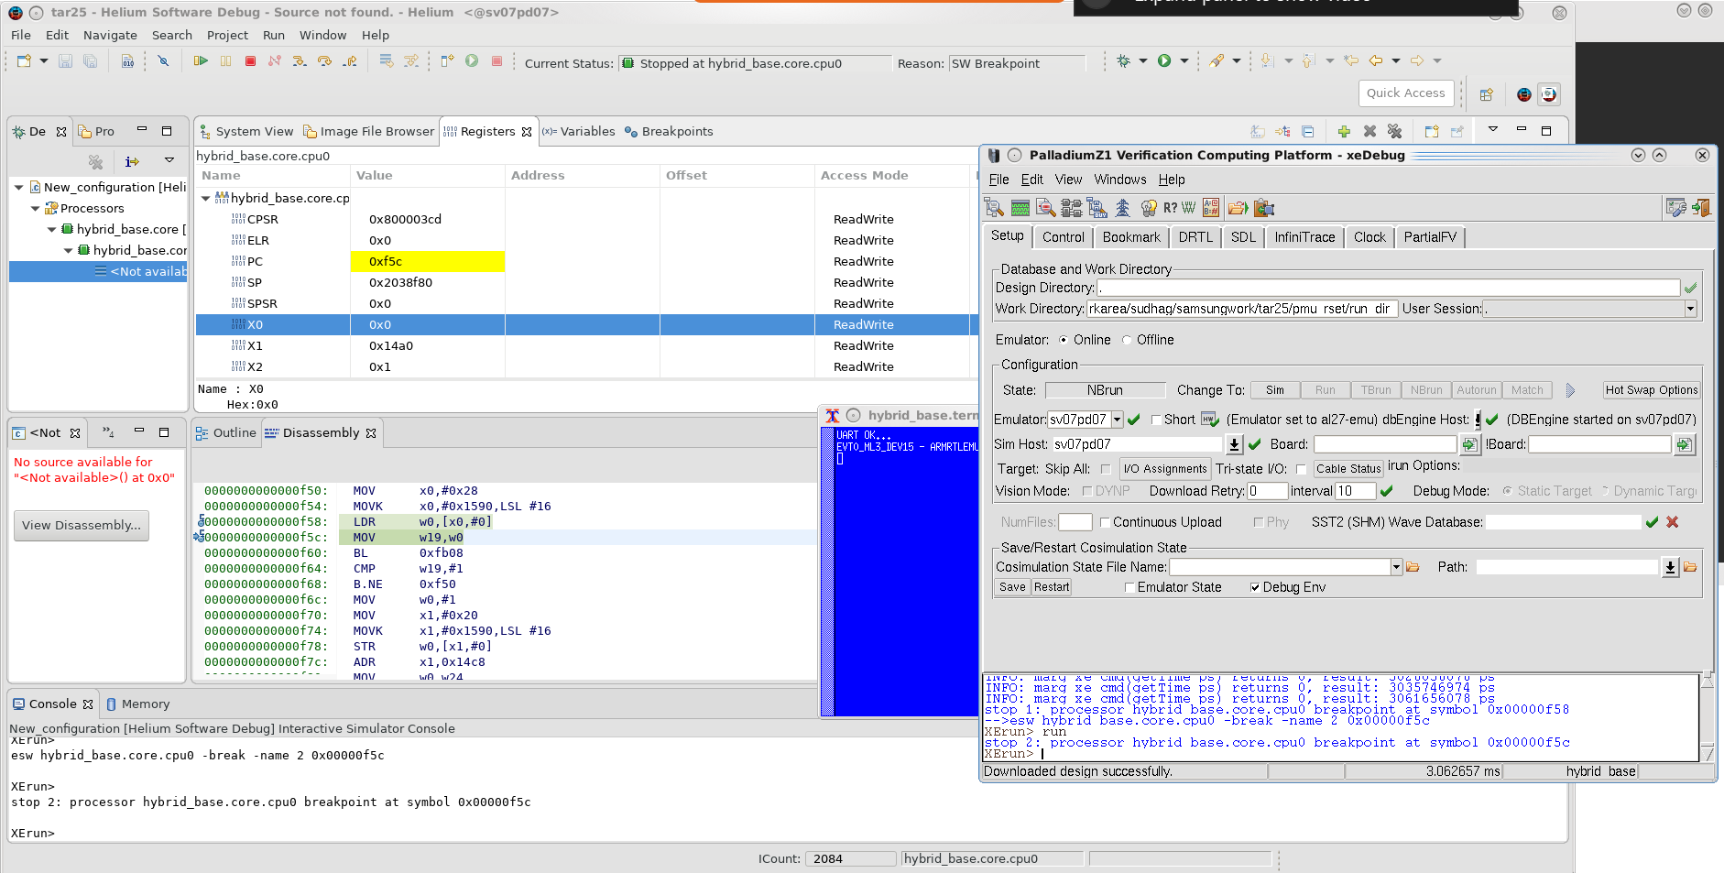
Connect the Helium SW Debugger
TODO:
Read to Mail box Address 0x15900028
Read to Mail box Address 0x15900028 returns value 0, which leads to hang

Slide 67
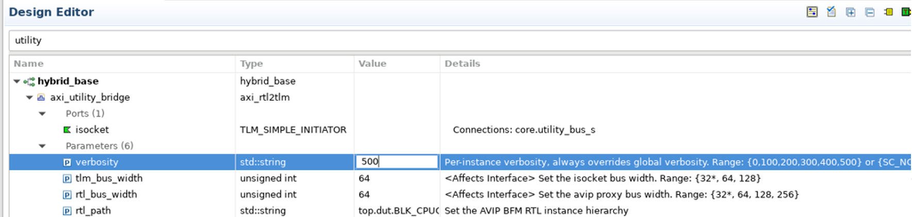
Enable AVIP BFM Verbosity
AVIP BFM Verbosity is useful for analyzing the Transaction reaching to/from BFM
Possible configuration for all BFM: {0,100,200,300,400,500} -> {SC_NONE, SC_LOW,SC_MEDIUM,SC_HIGH,SC_FULL,SC_DEBUG}
setenv AVIP_VERBOSITY FULL

Slide 68
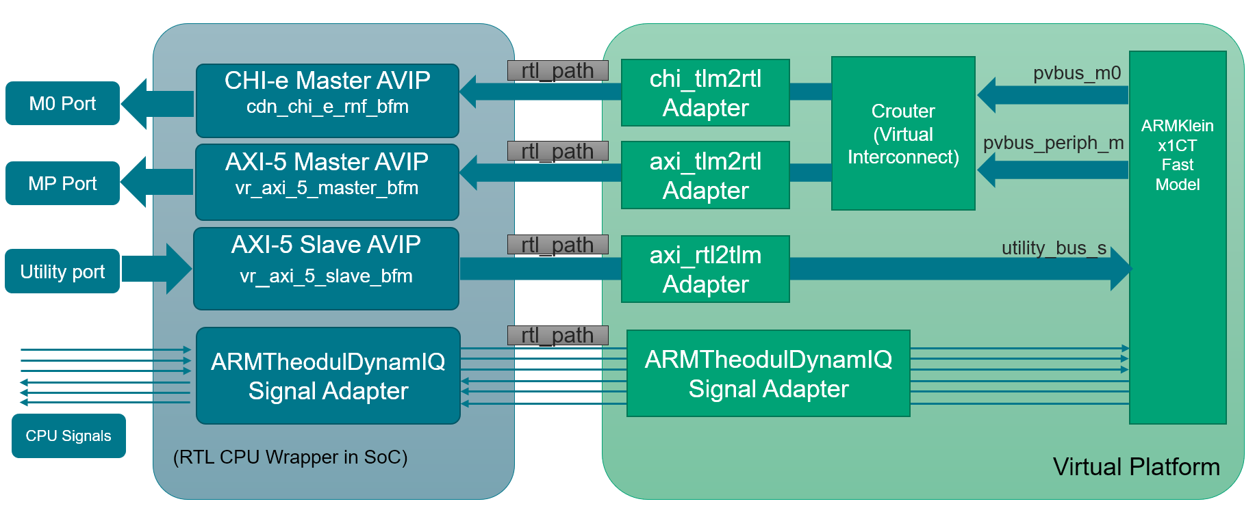
PPU Accesses Hung​
SW was hung at read to MAILBOX_APM_AP (0x15900028)
and was expecting read value = 1
Started debugging transactions happening around 0x15900028 address
With Utility AVIP BFM Verbosity enabled to full, we found the Read Transaction hung at 0x30008 address read
HW Transactions:
PMU ROM boot code initiates the PPU (Power Policy Unit) Config transactions to BLOCK1 IP Module.​
BLOCK1 Module diverts the transactions to CPU Wrapper at Utility Bus Interface targeting to PPU address space.​
Utility Slave BFM in CPU wrapper will divert the PPU register accesses to Klein CPU Fast Model’s utility bus using AXI_RTL2TLM adaptor.​
Write transactions to PPU_PWPR (0x03_0000) register followed by read transaction to PPU_PWSR(0x03_0008) register hung
Read Expected value was not matching​. It was always reading 0x0.
ARM Fast model is NOT working as expected and does not return the expected status by reading PPU_PWSR (0x03_0008) register.
Using Tcl scripting, implemented the force on AXI Slave BFM Read data path to drive the expected values so that PMU boot code moves ahead and does not hang.​
PMU_UP signal is asserted after the above adjustment using Tcl scripting​
SW hang issue resolved and Linux was booting successfully
Reason for SW Hang

Slide 69
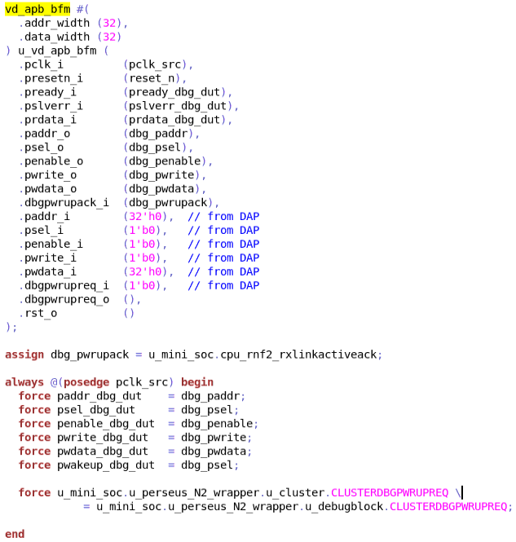
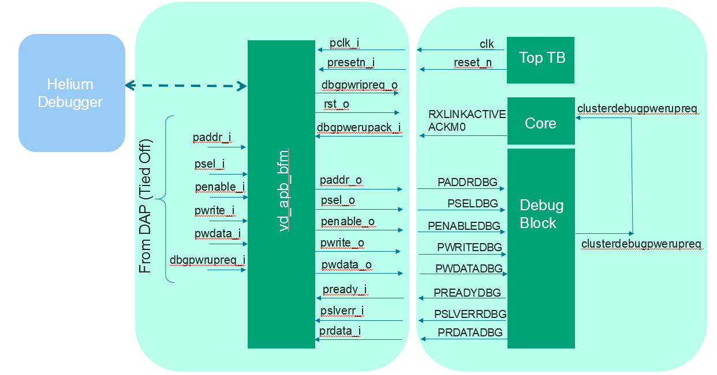
Connecting - Helium With an RTL Platform RTL Design Bring-up with Helium SW Debug
Instantiate ABP BFM Adapter
vd_apb_bfm
Add xrun switches
-helium
-esw config:<path/to/esw.config>
Notes:
09/07/21: Check with Ashwin on the available RTL database and also copy the relevant slides from gearshift training. – Done

Slide 70
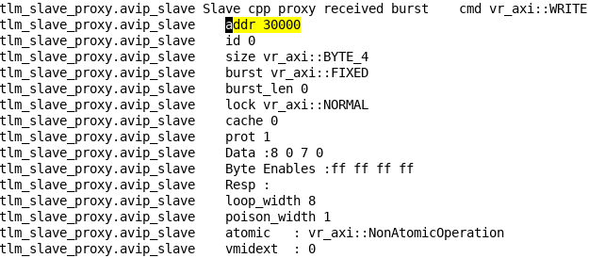
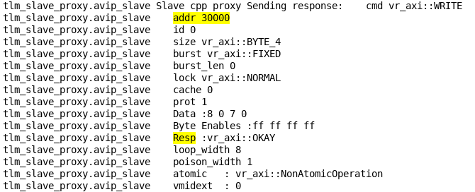
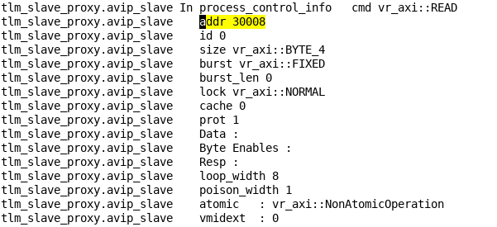
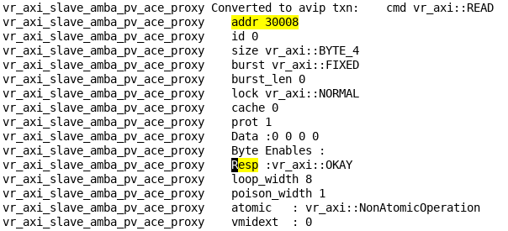
AVIP Verbosity Logs
Write Request to 0x30000 received
Valid Write Resp given back
Read Data is always 0
Read Request to 0x30008 received

Slide 71
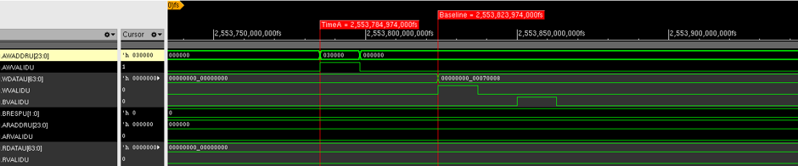

PPU Accesses Hang​
Choose Starter Platform
Save to Catalog
Add / Remove Virtual Models
Parameter Config / Port Binding
Rewire Interrupt and Memory Map
Add / Remove RTL Stubs
Hybrid Adaptors & RTL Connection
RTL Side changes
Build & Run
Debug
Write to 0x3_0000 PPU reg was successful
Read from 0x3_0008 PPU reg hung. Read value is always 0x0.

Slide 72
PPU Accesses Hung​
AVIP Logs
2. SW Reads Mailbox Register and hangs as read value != 1
2
RTL
CPU Wrapper
PMU_UP
7. SW Reads Mailbox Register with read value == 1
7
1
8
SoC Rest of RTL
1. Power Management Unit running firmware to initialize SoC
8. SW Hang Resolved !!
3
CPU-FM
3. PMU writes to PPU registers
M0 BFM
Interconnect
4. PMU reads PPU status registers and Hangs as status != 1
4
PPU registers
Utility BFM
5. Mailbox is not update and Hence SW is Hung
5
Helium
PMU-SS
6
6. Stub the expected value on PPU Reg, allows PMU FW to move ahead. PPU updates the Mailbox.
Xcelium
Palladium

Slide 73
Connecting - Helium With an RTL Platform

Slide 74
Connecting - Helium With an RTL Platform Connecting the RTL CPU to the Helium debugger
Add to existing hybrid TB
RTL
GIC600
CPU A76x4
vd_apb_bfm
To Helium debugger
NIC400
Connecting the RTL CPU to the Helium debugger
SRAM
Configuration file:
processor {
...
bfm
{
path tb_top.vd_apb_bfm
type apb
adapter vdi
}
...
ROM
DDR
UART(0-3)

